Slide 1
History of Research Ethics

Slide 2

Published article in the Lancet in 1998
Claimed relationship between MMR vaccine & Autism
DEBUNKED
Problems…
Vaccines &
Autism

Slide 3
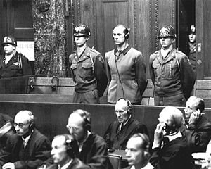
Nuremberg, 1947
Nazi physicians on trial for conducting cruel experiments on concentration camp prisoners during WWII.
Breaking bones
High Altitudes and freezing waters
Physicians convicted
Result: The Nuremberg Code

Slide 4
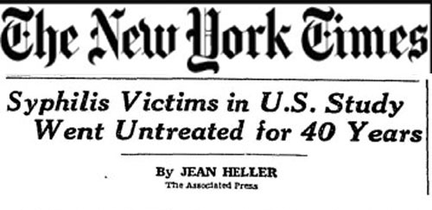
Tuskegee Syphilis Study 1932-1972
Conducted by the US Public Health Service.
Poor African American men in Tuskegee Alabama
Given free medical care, but not treated for their syphilis.
Men were denied treatment in order to see the disease progression.
Researchers need to consider issues of justice and fairness at the societal level.
“So today, America does remember the hundreds of men used in research without their knowledge and consent. We remember them and their family members. Men who were poor and African American, without resources and with few alternatives, they believed they had found hope when they were offered free medical care by the United States Public Health Service. They were betrayed.” – Bill Clinton

Slide 5
Milgram (1963)
Studying obedience to authority
Participants required to administer “shocks” to people for responding incorrectly.
Shocks would get higher in intensity (fatal)
These fake shocks caused severe psychological stress to subjects in this experiment
“in a large number of cases, the degree of tension reached extremes that are rarely seen in sociopsychological laboratory studies. Subjects were observed to sweat, tremble, stutter, bite their lips, groan, and dig their fingernails into their flesh. On one occasion we observed a seizure of laughter so violently convulsive that it was necessary to call a halt to the experiment. Another observer reported that within 20 minutes one participant was reduced to a twitching, stuttering wreck, who was rapidly approaching the point of nervous collapse”
https://www.youtube.com/watch?v=xOYLCy5PVgM

Slide 6

Haney, Banks, & Zimbardo (1973)
Prison Study. Randomly assigned subjects to play a prisoner or guard.
Prisoners showed depression/helplessness
Guards became aggressive and dehumanizing
Experiment was stopped short for the safety of participants.
Need to monitor the well-being of subjects in research.
https://www.youtube.com/watch?v=DsWJPNhLCUU

